Slide 1

Quadratic equations

Slide 4

Find the roots of the equation
i. $x^{2}$ + 3x – 4 = 0
ii. 4$x^{2}$ - 13x + 10 = 0
iii. 26$x^{2}$ - 43x + 15 = 0

Slide 5

2. Find the roots of the equation
i. $x^{3}$ +${13x}^{2}$ + 32x + 20 = 0
ii. $x^{3}$ - 7$x^{2}$ + 4x + 12 = 0
iii. $2x^{4}$ - 5 $x^{2}$ + 3 = 0
iv. $x^{3}$ - 4$x^{2}$ - x + 1 = ${(x −1)}^{2}$ . Find ‘x’

Slide 6

3. Discuss the nature of the roots of the equation:
i. 4$x^{2}$ - 2x + 1 = 0
ii. x² – 4x + 4=0
a. infinite
b. two distinct real roots
c. two equal real roots
d. two complex roots

Slide 7
4. i. Form the quadratic equation whose roots are 2 and 7
ii. Form a quadratic equation with rational coefficients, one of whose roots is 3 + √5.

Slide 8

5. If $α$ , $β$ are the roots of the polynomial $x^{2}$ - 7x + 12 = 0
Then ($α^{2}$ + $β^{2}$)($β$ - $α$) =
25
b. 36
c. 49
d. 64

Slide 9

6. If $α$ , $β$ are the roots of the polynomial $x^{2}$ - 9x + 18 = 0
Then $αβ$/ ($α$ +$β$ )
a. 2
b. 3
c. 4
d. 5

Slide 10
7. If α and β are roots of the equation x²-x-1=0,then the equation whose roots are α/β and β/α is:
a. x²+3x-1=0 b. x²+x-1=0 c. x²-x+1=0 d.x²+3x+1=0

Slide 11

8. If α and β are roots of the equation a$x^{2}$ + bx + c = 0
,then the equation whose roots are 1/β and 1/α is:
bx²+cx+a=0
b. cx²+ax+b=0
c. cx²+bx+a=0
d. cx²⁻bx+a=0

Slide 12

9. Sum of the roots of the equation 4$x^{3}$ - ${8x}^{2}$ + 13x - 9 = 0 is
-8
b. -2
c. 8
d. 2

Slide 13
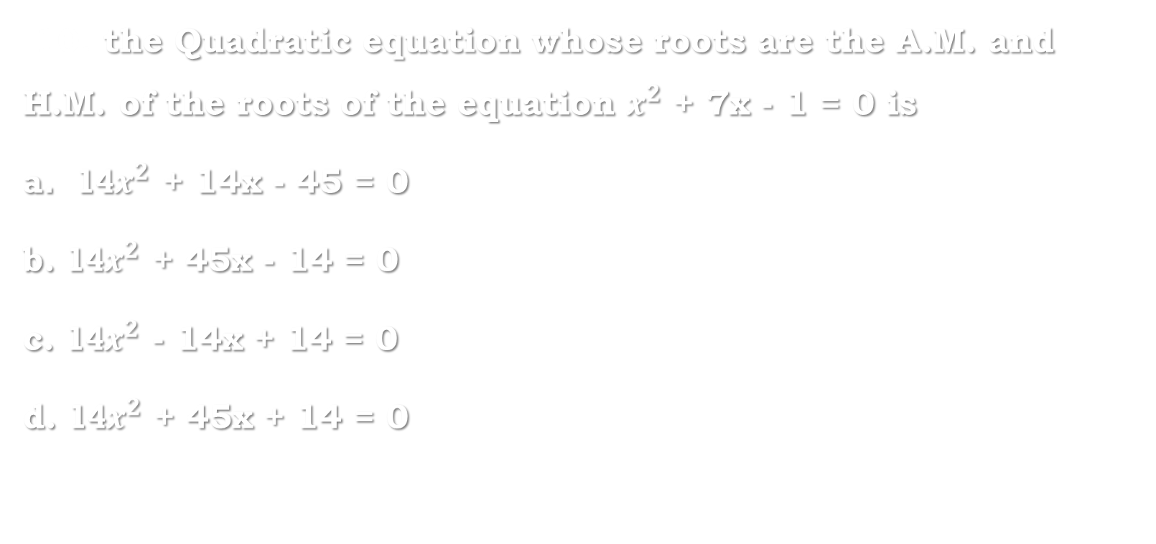
10. the Quadratic equation whose roots are the A.M. and H.M. of the roots of the equation $x^{2}$ + 7x - 1 = 0 is
14$x^{2}$ + 14x - 45 = 0
b. 14$x^{2}$ + 45x - 14 = 0
c. 14$x^{2}$ - 14x + 14 = 0
d. 14$x^{2}$ + 45x + 14 = 0

Slide 14

11. If the roots of the equation 3$x^{2}$ + 9x + 2 = 0 are in the ratio m:n. then find $\sqrt{\frac{m}{n}}$ + $\sqrt{\frac{n}{m}}$
a. $\frac{−3\sqrt{3}}{\sqrt{2}}$
b. $\frac{3\sqrt{2}}{2}$
c. $\frac{3\sqrt{3}}{\sqrt{2}}$
d.$\frac{−3\sqrt{3}}{2}$

Slide 15
12. if (x+2)(x+4)(x+6)(x+8)= 945 and x is an integer, then find x?
-1 or -11
b. 1 or -11
c. -1 or 11
d. 1 or 11

Slide 16

13. find the maximum or minimum value of the quadratic expression $x^{2}$ - 3x + 5 = 0
The minimum value is 9/10
b. The minimum value is 11/4
c. The maximum value is 9/10
d. The maximum value is 11/4

Slide 17

14. find the maximum value of the quadratic expression
-3$x^{2}$ + 5x - 12 = 0
a. -119/12 at x = -5/3
b. -119/12 at x = 5/6
c. 119/12 at x = -5/6
d. 119/12 at x = 5/3

Slide 18

15. If a polynomial f(x) = 8$x^{3}$ - 4x + 5 is divided by 2x-5, then the remainder is:
a. 120
b. 110
c. 101
d. 102

Slide 19

16. When the polynomial 7$x^{3}$ - $5x^{2}$ + ax - 3 is divided by x-2, the remainder is 55 then $a^{2}$ =
a. 121
b. 144
c. 100
d. 154

Slide 20

16. If the polynomial 8$x^{4}$ - $6x^{3}$ + 4$x^{2}$ + ax + b is divisible by
(x-1) and (x+1), then $b^{2}$ - $a^{2}$ =
a. 100
b. 203
c. 302
d. 108

Slide 21
THE END

